Slide 1

Design and Analysis of Algorithms
Dinesh Singh
Department of Computer Science & Engineering

Slide 2
DESIGN AND ANALYSIS OF ALGORITHMS
Greedy Technique – Dijkstras Algorithm
Dinesh Singh
Department of Computer Science & Engineering

Slide 3
Design and Analysis of Algorithms
Greedy Technique – Dijkstras Algorithm
Dijkstras Algorithm : single-source shortest-paths problem
For a given vertex called the source in a weighted connected graph, find shortest paths to all its other vertices.
Dijkstra’s algorithm is applicable to undirected and directed graphs with nonnegative weights only

Slide 4
Design and Analysis of Algorithms
Greedy Technique – Dijkstras Algorithm
Dijkstras Algorithm : single-source shortest-paths problem
Dijkstra’s algorithm finds the shortest paths to a graph’s vertices in order of their distance from a given source.
It follows a greedy approach, repeatedly selecting the vertex with the minimum tentative distance from the source and updating (relaxing) the distances of its adjacent vertices.
The algorithm processes vertices in increasing order of their shortest distance from the source..

Slide 5
Design and Analysis of Algorithms
Greedy Technique – Dijkstras Algorithm
Dijkstras Algorithm : single-source shortest-paths problem
Before the i^{th} iteration begins, the algorithm has already determined the shortest paths from the source to i−1 vertices.
These i−1 vertices, along with the edges forming their shortest paths, constitute a subtree T_{i−1} ​ of the graph.
The vertices adjacent to those in T_{i−1} ​ are called fringe vertices. These vertices are candidates from which the algorithm selects the next vertex with the minimum distance from the source.

Slide 6
Design and Analysis of Algorithms
Greedy Technique – Dijkstras Algorithm
Dijkstras Algorithm : single-source shortest-paths problem
Vertex Selection Step
To identify the i^{th} nearest vertex, the algorithm evaluates all fringe vertices.
For each fringe vertex u, it computes:
  the shortest known distance to a tree vertex v, plus
  the weight of the edge (v,u).
The vertex u with the minimum value is selected and added to the shortest-path tree.

Slide 7
Design and Analysis of Algorithms
Greedy Technique – Dijkstras Algorithm
Dijkstras Algorithm : single-source shortest-paths problem
To implement the algorithm, each vertex is assigned two labels:
A distance label d, which represents the length of the shortest path from the source to that vertex discovered so far.
A predecessor label, which stores the previous vertex on the current shortest path.
Using these labels, the next vertex u∗ is selected by choosing the fringe vertex with the minimum distance label d.

Slide 8
Design and Analysis of Algorithms
Greedy Technique – Dijkstras Algorithm
Dijkstras Algorithm : single-source shortest-paths problem
After selecting a vertex u∗, the following operations are performed:
Move u∗ from the fringe set to the tree (visited) set.
For each vertex u adjacent to u∗, perform the following:
  If d[u]>d[u∗]+w(u∗,u)
  then update:
    d[u]=d[u∗]+w(u∗,u)
    pred[u]=u∗

Slide 9
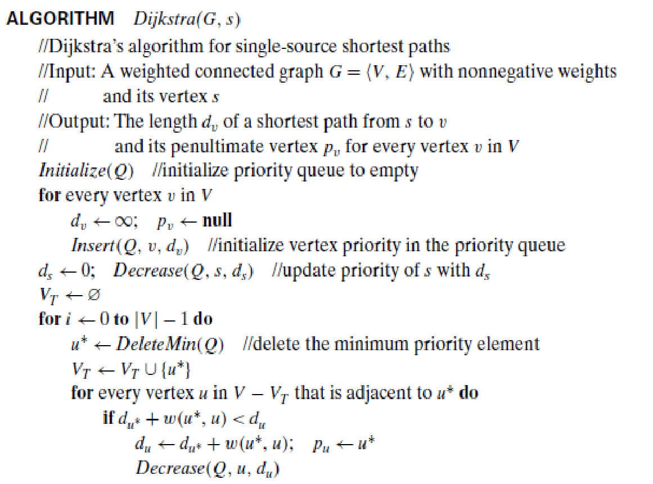
Design and Analysis of Algorithms
Greedy Technique – Dijkstras Algorithm

Slide 10
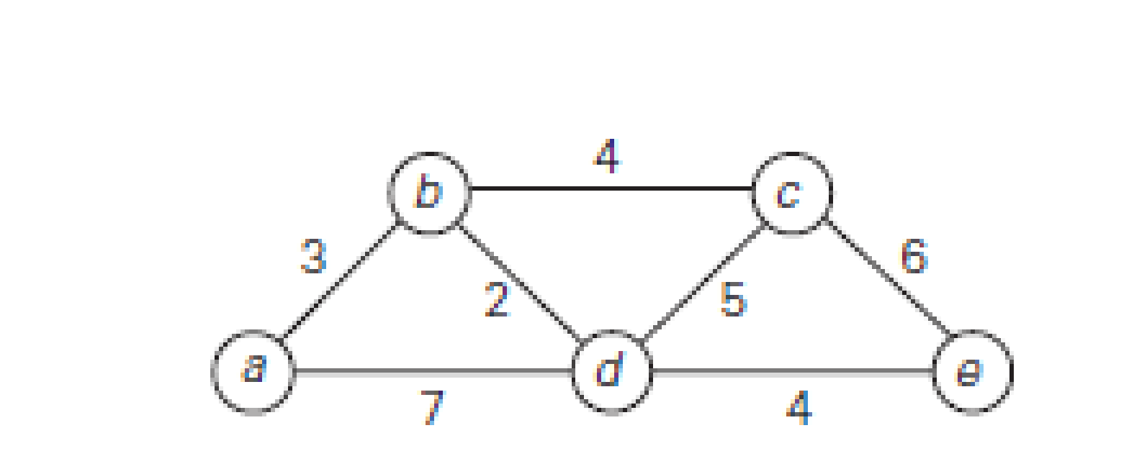
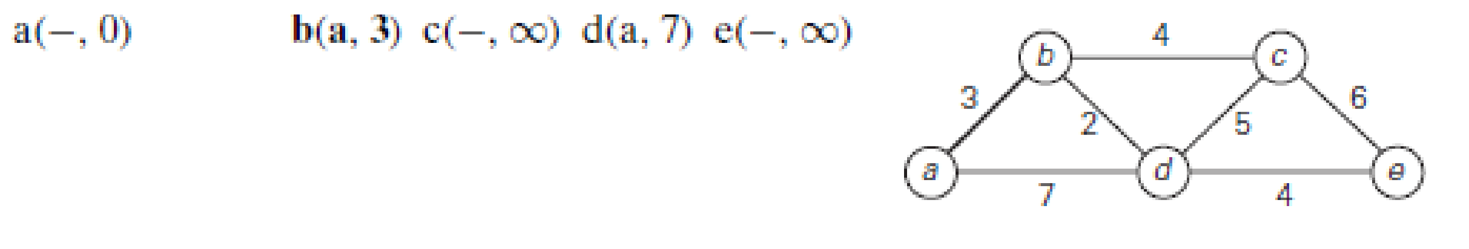
Design and Analysis of Algorithms
Greedy Technique – Dijkstras Algorithm

Slide 11
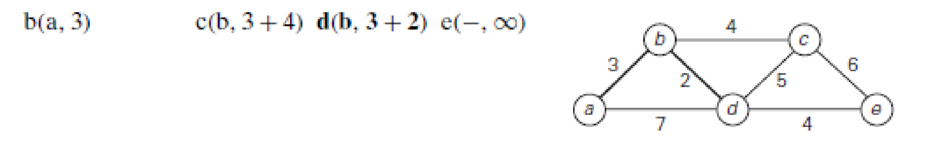
Design and Analysis of Algorithms
Greedy Technique – Dijkstras Algorithm

Slide 12
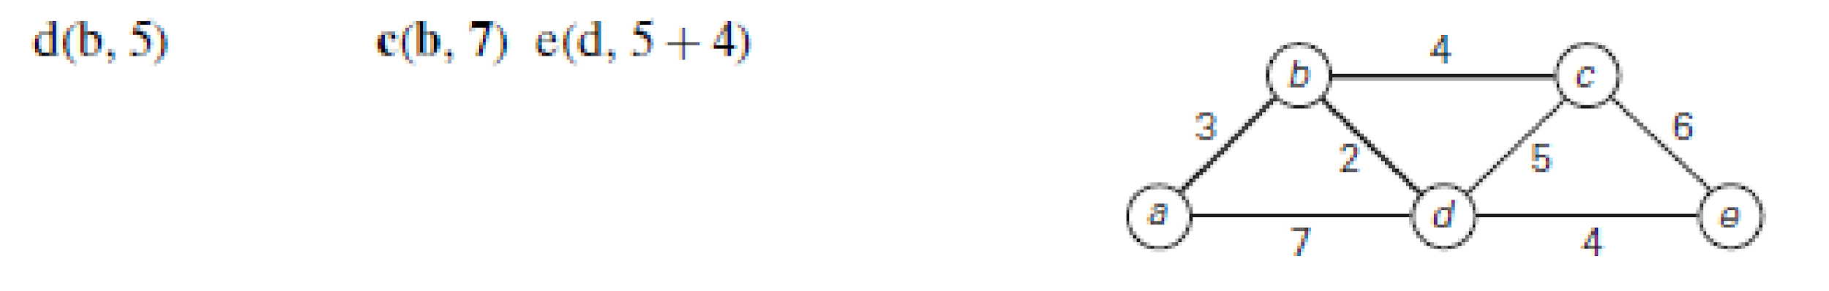
Design and Analysis of Algorithms
Greedy Technique – Dijkstras Algorithm

Slide 13
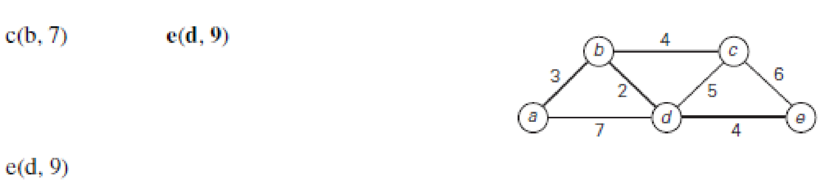
Design and Analysis of Algorithms
Greedy Technique – Dijkstras Algorithm

Slide 14
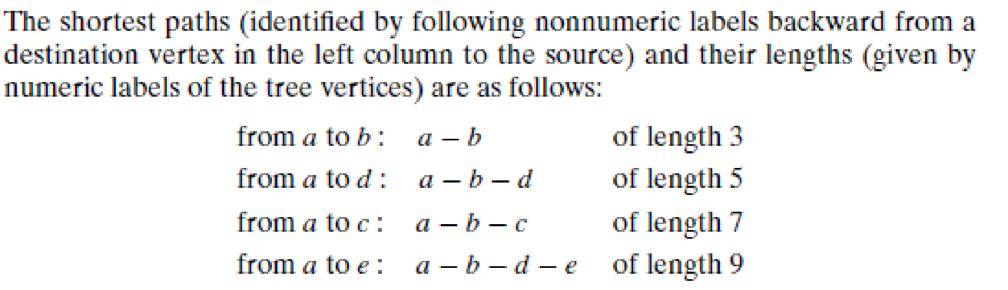
Design and Analysis of Algorithms
Greedy Technique – Dijkstras Algorithm

Slide 15
Design and Analysis of Algorithms
Greedy Technique – Dijkstras Algorithm
The time efficiency of Dijkstra’s algorithm depends on the data structures used for implementing the priority queue and for representing an input graph itself
If the Graph represented as adjacency matrix and priority queue as an unordered array
Extract-Min Operation (Unordered Array)
To find the minimum d[v], we must scan all vertices
Cost per extraction = ϴ(V)
Number of extractions = V
Total cost= ϴ(V²)

Slide 16
Design and Analysis of Algorithms
Greedy Technique – Dijkstras Algorithm
Relaxation Step (Adjacency Matrix)
For each selected vertex u∗, we check all possible vertices
Because matrix representation requires scanning an entire row
Cost per iteration = ϴ(V)
Total iterations = V
Total cost= ϴ(V²)
Updating Distance Values
Updating d[v] in an unordered array = ϴ(1)
Final Complexity : ϴ(V²)

Slide 17
Design and Analysis of Algorithms
Greedy Technique – Dijkstras Algorithm
If the Graph represented as adjacency list and priority queue as a min heap
Extract-Min (Heap)
Each extract-min operation costs:
ϴ(logV) Performed V times:
Total= ϴ(VlogV)
Relaxation (Adjacency List)
Each vertex processes only its adjacent edges
Total edges processed = E
Total relaxation work= ϴ(E)

Slide 18
Design and Analysis of Algorithms
Greedy Technique – Dijkstras Algorithm
Decrease-Key Operations
Each relaxation may trigger a decrease-key
Each decrease-key costs:
ϴ(logV) In worst case, done for each edge:
Total= ϴ(ElogV)
Total Complexity
ϴ(VlogV)+ ϴ(ElogV) = ϴ((V+E)logV)
For connected graphs, E≥V−1, so:
ϴ(Elog⁡V)

Slide 19
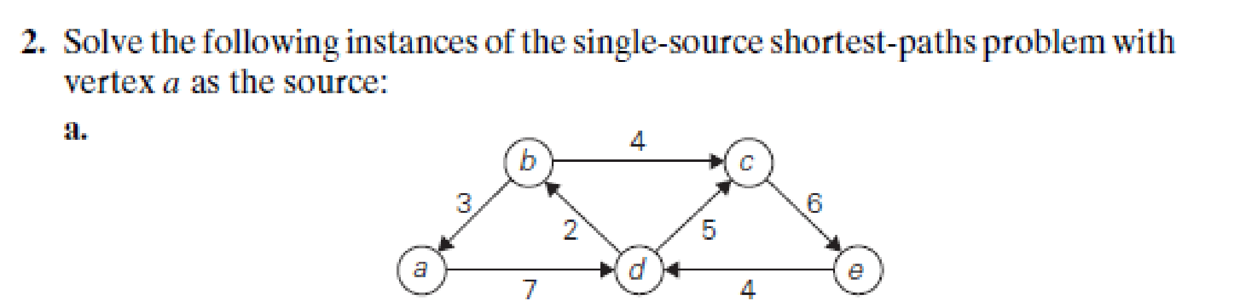
Design and Analysis of Algorithms
Greedy Technique – Dijkstras Algorithm

Slide 20
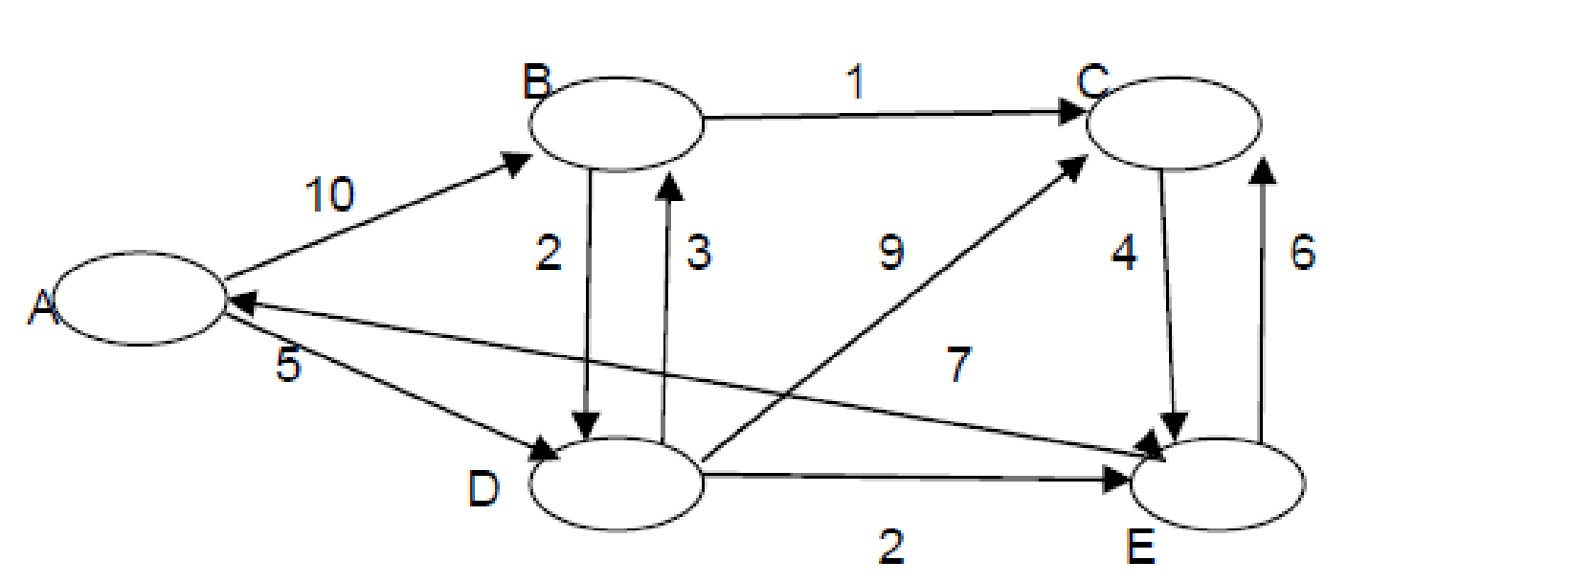
Design and Analysis of Algorithms
Greedy Technique – Dijkstras Algorithm
Apply Dijkstra’s algorithm to find single destination shortest paths for the given graph with respect to the destination node E .
Hint : you may want to reverse the directions of edges to change destination to source.

Slide 21
Design and Analysis of Algorithms
Multiple Choice Questions
Which of the following statements is always true before the start of the i^{th} iteration of Dijkstra’s algorithm?
All vertices have their final shortest path distances
Exactly i vertices have been permanently labeled
The shortest paths to i−1 vertices have been correctly determined
The fringe set contains exactly i−1 vertices
Answer : C. The shortest paths to i−1 vertices have been correctly determined

Slide 22
Design and Analysis of Algorithms
Multiple Choice Questions
During the relaxation step, which condition correctly determines whether the label of a vertex u should be updated?
d[u]<d[u∗]+w(u∗,u)
d[u]=d[u∗]+w(u∗,u)
d[u]>d[u∗]+w(u∗,u)
w(u∗,u)>d[u∗]
Answer C. d[u]>d[u∗]+w(u∗,u)

Slide 23
Design and Analysis of Algorithms
Multiple Choice Questions
In Dijkstra’s algorithm, the predecessor label of a vertex is primarily used to:
Determine the next vertex to be selected
B. Compute edge weights dynamically
C. Reconstruct the shortest path after execution
D. Store the degree of the vertex
Answer C. Reconstruct the shortest path after execution

Slide 24
Design and Analysis of Algorithms
Multiple Choice Questions
Consider the subtree T_{i−1}​ formed during execution. Which statement is correct?
It contains all vertices of the graph
B. It may contain vertices whose shortest paths are not finalized
C. It contains vertices with finalized shortest paths from the source
D. It only contains leaf nodes of the graph
Answer C. It contains vertices with finalized shortest paths from the source

Slide 25

THANK YOU
Dinesh Singh
Department of Computer Science & Engineering

